Slide 1
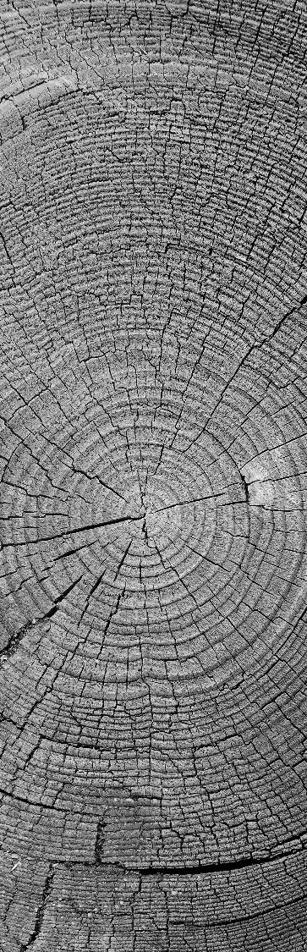
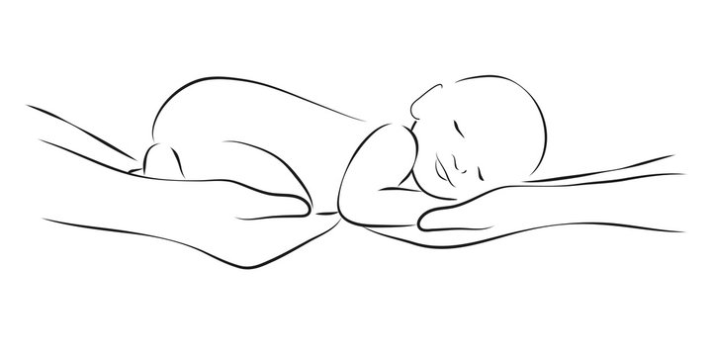
PEDREATIC SLEEP PATTERNS
ST. CLAIR COLLEGE
Healthcare Analytics
Group Project

Slide 2

Group members
STUDENT NAME | SECTION | STUDENT ID
Ankush Saxena | 002 | 0770764
Avalvir Sekhon | 002
Ayushi Jain | 002
Arpan Das | 002 | 0770101

Slide 3
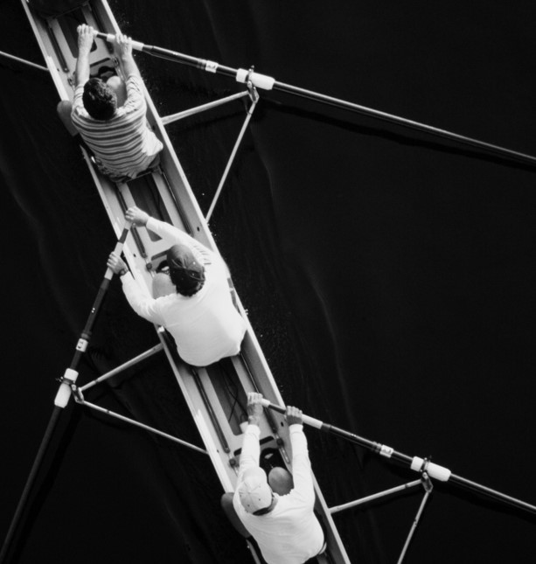
PROJECT SCOPE
UNDERSTAND
Study and understand the effects of specific factors on a child’s sleep
DEVELOP
Devising the ideal conditions for pediatric sleep
PREDICT
Predict the amount of different kind of sleeps under specific conditions

Slide 4

DESCRIPTION
NCH Sleep
BACKGROUND
Sleep is an active process associated with physiological changes that involve multiple organ systems, and is vital for the maturation and daily functioning of infants, children, and adolescents. Some infants and children require an analysis while actually sleeping, called an overnight sleep study or Polysomnography (PSG), to accurately diagnose their sleep-related condition.
ABSTRACT
In order to accelerate research on pediatric sleep and its connection to health, Nationwide Children's Hospital (NCH) and Carnegie Mellon University (CMU) introduce the NCH Sleep DataBank. This dataset has 3,984 pediatric sleep studies on 3,673 unique patients conducted at NCH in Columbus, Ohio, USA between 2017 and 2019, along with the patient's longitudinal clinical data

Slide 5

NOVELTY OF THE DATASET
The size of the database is suitable for discovering new scientific insights via data mining, i.e., 1.2 Terabytes.
Patient population: It mostly focuses on pediatric patients,
Clinical setting: The sleep studies were gathered in the real-world clinical setting at NCH as opposed to, for example, in a controlled clinical trial, and
Rich set of clinical data: The accompanying 5.6 million records Size: Its large of clinical data are extracted from the Electronic Health Record (EHR), and are separated into encounters, medications, measurements (e.g. body mass index), diagnoses, and procedures.
The NCH Sleep Databank is a valuable resource for advancing automatic sleep scoring and real-time sleep disorder prediction, among many other potential scientific discoveries. Accompanying code in Python to assist users in interacting with the dataset is published on GitHub.

Slide 6


Data dataset
BASE FOLDER
DESCRIPTION
The NCH Sleep Databank consists of two folders: Sleep_Data and Health_Data.
Sleep_Data contains annotated PSG recordings, while Health_Data contains patient demographic and clinical data extracted from the EHR.
Health_Data
Sleep_Data
…
…
…

Slide 7
Data dataset
SLEEP DATA
DESCRIPTION
Inside Sleep_Data, PSG sleep studies are provided in the EDF format [2], and annotations are provided in a separate WFDB-format and Tab-Separated Value (TSV) files.
Sleep studies and their matched annotations share the same file name (STUDY_PAT_ID)_(SLEEP_STUDY_ID) but different extensions (.edf for the waveforms and .atr/.tsv for the annotations).
10000_17728.atr
10000_17728.edf
10000_17728.tsv
. ---
. ---
. ---
. ---

Slide 8
Data dataset
HEALTH DATA
DESCRIPTION
Clinical data in Health_Data are in Comma-Separated Value (CSV) files, and they are linked to the files in Sleep_Data through the same STUDY_PAT_ID.
Variables follow EHR conventions and descriptions can be found in the file Sleep_Study_Data_File_Format.pdf. This includes patient demographics and longitudinal clinical data such as encounters, medication, measurements, diagnoses, and procedures.
DEMOGRAPHIC.csv
DIAGNOSIS.csv
ENCOUNTER.csv
. ---
. ---
. ---
. ---

Slide 9
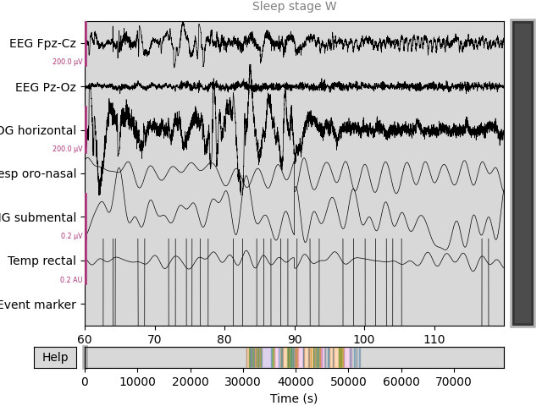
Sleep stage classification for PSG data validation
A baseline sleep stage classifier was developed and included in the codebase to demonstrate the technical quality as well as a potential utility of the dataset, especially the PSG data.
This simple algorithm predicts the sleep stages (wake, light sleep, deep sleep, REM, and repeat or W, N1, N2, N3, R) based on 30 seconds of 7 EEG channels (F4-M1, O2-M1, C4-M1, O1-M2, F3-M2, C3-M2, CZ-O1) after they are down sampled to 128Hz.
After applying multi-resolution Daubechies wavelet transform to each EEG channel, we computed summary statistics such as min, max, mean, and standard deviation of the coefficients, resulting in 84 features. A random forest classifier with 100 decision trees was then trained on these features using 67% of the dataset, and tested on the rest.

Slide 10
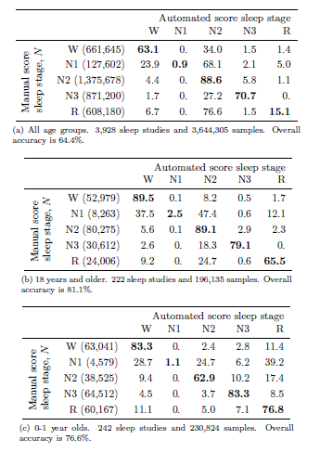
Sleep stage classification for PSG data validation
This table reports the 3-fold stratified cross validation results on 3,928 sleep studies that had the 7 EEG channels, in addition to the results on some subgroups (0 to 1 year old, 1 to 2 years old,
and 18+ patients). Fitting the classifier with default parameters from Scikit-learn took 1 hour on Intel Xeon Gold 3.60GHz CPU in parallel; subgroups took less than 2 minutes each.
This quick and straightforward algorithm, without any denoising or parameter tuning, achieves a classification accuracy of over 80% on the 222 adult sleep studies, suggesting high quality of the PSG recordings.
Moreover, the difference in classification results between age groups supports the importance of having a dataset dedicated to pediatric sleep.

Slide 12
THANK YOU

